Slide 1
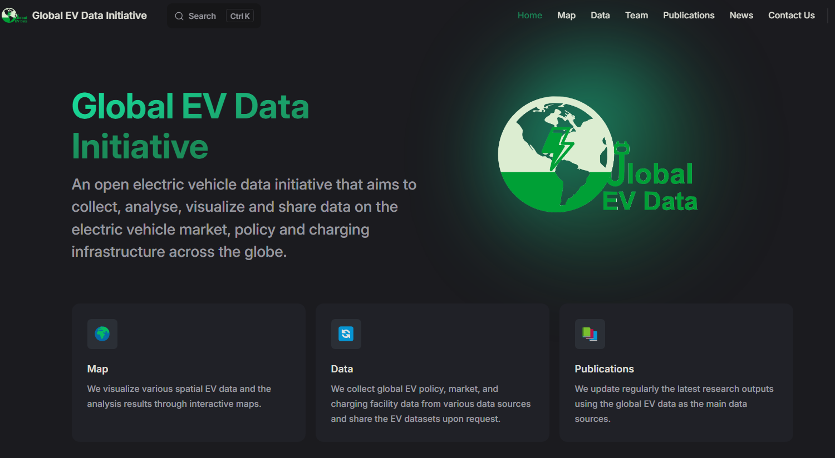

首页参照Global EV改
Hong Kong eBus Study
This study focuses on optimizing Hong Kong's electric bus system using data-driven methods to enable large-scale electrification.
We visualize various spatial bus data and the analysis results through interactive maps.
We collect route and real-time data of Hong Kong’s buses, along with other spatial data and share the datasets upon request.
把global EV改成HK eBus

Slide 2
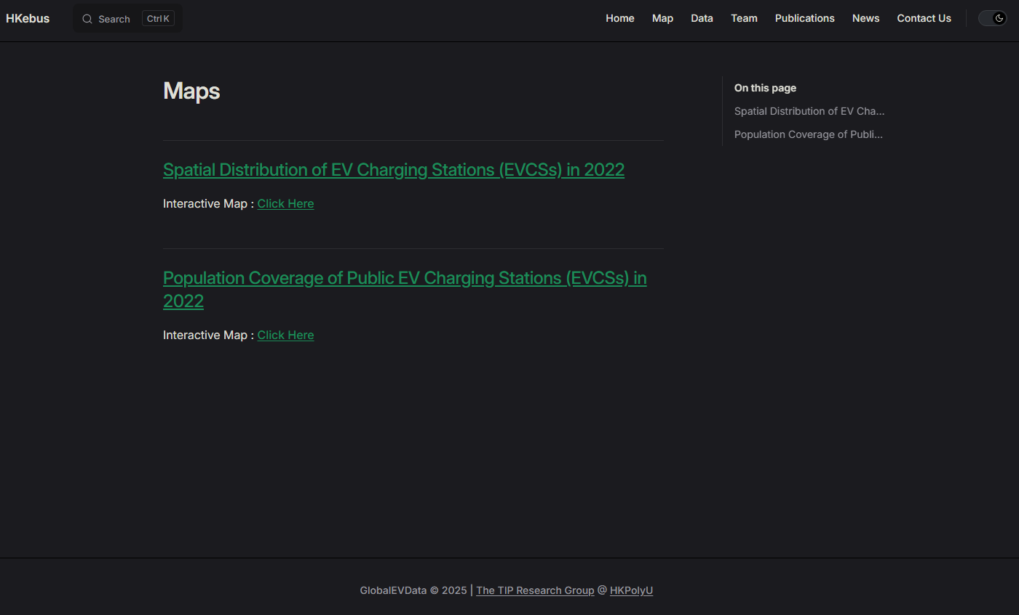
Flow Map of Bus in Hong Kong
Trajectory Map of Bus in Hong Kong
底部改成HKeBus

Slide 3
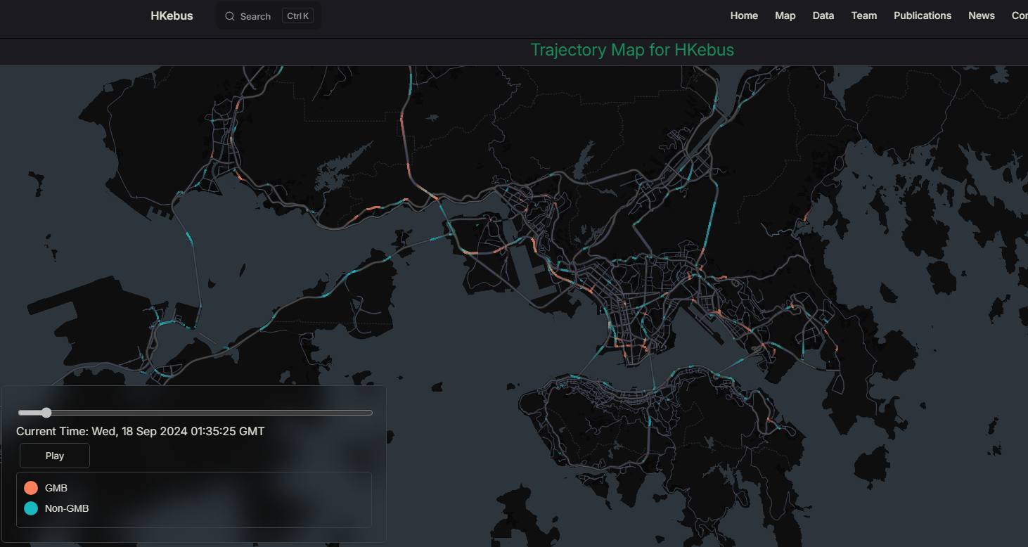
标题：Trajectory Map of Bus in Hong Kong
另一张地图里面的标题也改下
GMT+8
蓝色的改名为Bus，红色改名为Minibus，蓝色放在红色上方

Slide 4
Data
The data used in this study are all open-source data from DATA.GOV.HK.
1. Public Transport
1.1 Basic Information
Routes and fares of public transport
1.2 Estimated Time of Arrival (ETA)
Citybus and NLB
KMB
MTR (Feeder) Bus
GMB
2. Other Spatial Data
Road Network
Tertiary Planning Units & Subunits
Digital Terrain Model (DTM)
可点击的超链接请参照以上

Slide 5

Team参照Global EV的，人员换一下
PI: Tony
Researchers & Developers：
Zili TIAN Leading Researcher & PhD student
Shiqi WANG Leading Researcher & PhD candidate
Xiong Yang Leading Researcher & Postdoc Fellow
Zhiqing PAN Website Developer & Research Assistant
International Collaborators
Zhenhan PENG PhD Student at KU Leuven, Belgium
Jiaxing LIU Lecturer at Gannan University of Science and Technology
照片用课题组网站的就行，jiaxing的在这刘佳兴-赣南科技学院-资源与土木工程学院

Slide 6

1. Zhenhan Peng, Zhuowei Wang, Shiqi Wang, Anthony Chen, Chengxiang Zhuge*. (2024). Fuel and infrastructure options for electrifying public transit: A data-driven micro-simulation approach. Applied Energy, 369, 123577.

Slide 7
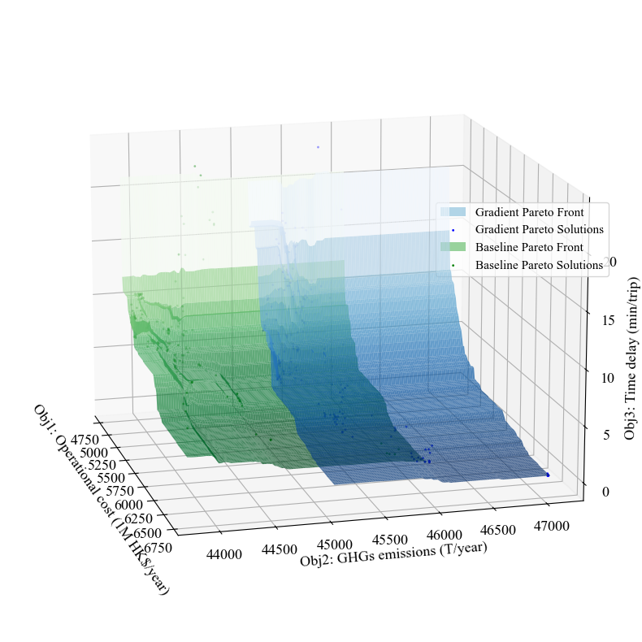
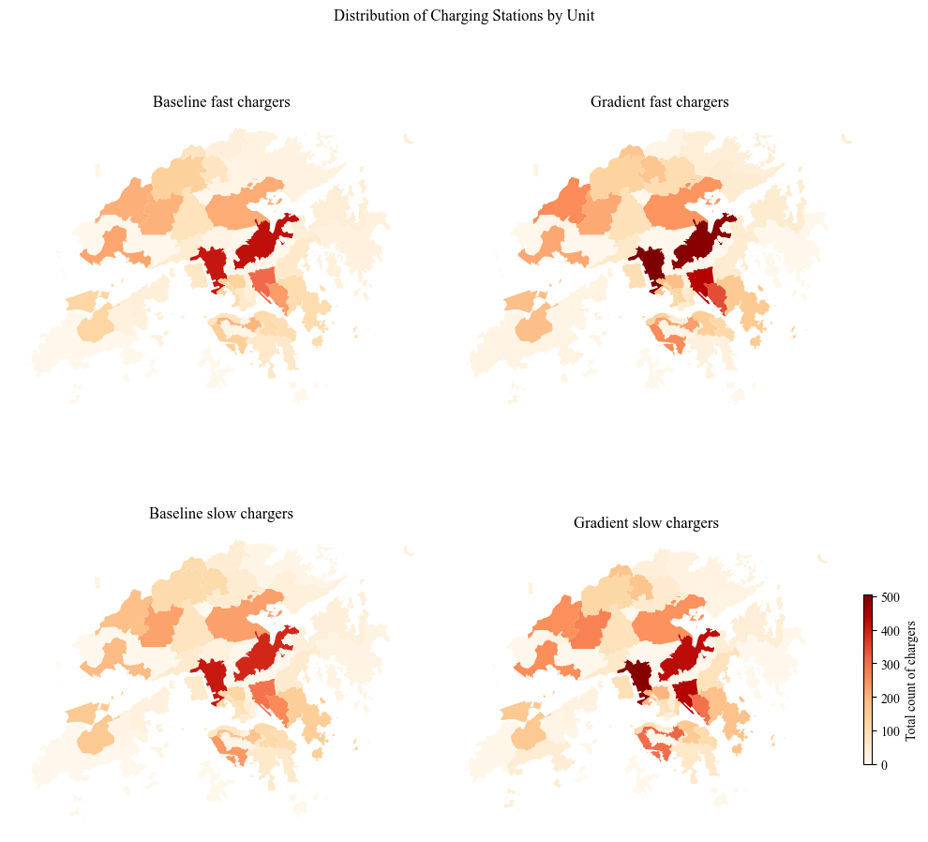
News
两张图插入文中的任何位置
Title: A Data-Driven Microsimulation-Based Optimization Model were developed for Electric Bus Systems in Hong Kong
As Hong Kong accelerates its ambitious efforts to electrify its bus fleet, we are excited to unveil an electric bus simulation model designed specifically for the city. Leveraging real-time bus arrival data, our team has reconstructed detailed full-day vehicle trajectories for Hong Kong’s bus network and accurately simulated the driving and charging behaviors of electric buses.
To tackle the complexities of large-scale bus electrification, we have integrated the microsimulation module into a multi-objective optimization framework. This innovative approach empowers us to devise practical and efficient solutions for Hong Kong’s electrification strategy. Key aspects addressed include the selection of electric bus models, determination of procurement quantities, and the optimal planning of charging infrastructure, etc.
Given Hong Kong’s challenging and varied terrain, we have further refined the simulation’s accuracy by incorporating gradient considerations. Our results highlight the critical role of terrain in shaping electrification schemes, demonstrating that accounting for gradients has a substantial and undeniable impact on the overall strategy.
This study marks a step forward in supporting Hong Kong’s transition to a sustainable, electrified public transportation system.

Slide 8

hkebus@outlook.com
HKeBus

